Slide 1
PTL U/P/H RVP SKU Strategy Rev 0.51
RVP Team
ACK: Patrick James, Chee chun, Nirmala Bailur, Venkataramani Gopalakrishnan, Klein Adi, Ranjul, Prashanth Bhat, Yuval Harrosh, Jeremy Littrell, Suresh Mani, Aviva Atkins, Matthew G, Evrim Binboga, Sajal Das

Slide 2
RVP Architecture I/P
Corporate
Premium Thin & Light
Premium Thin & Powerful
Slim Gaming/Creator
Chrome
PCB Type (T3,T4),
TDP (U,P,H),
Package (U,P,H)
EV, FV, PPV, PnP
Platform BOM
RVP
HSIO (PCD-P, H)
Type-C
HDMI, eDP
Storage NVMe, USB,UFS
Graphics
Memory
DDR5 SODIMM
CAMM
LP5x Down

Slide 3
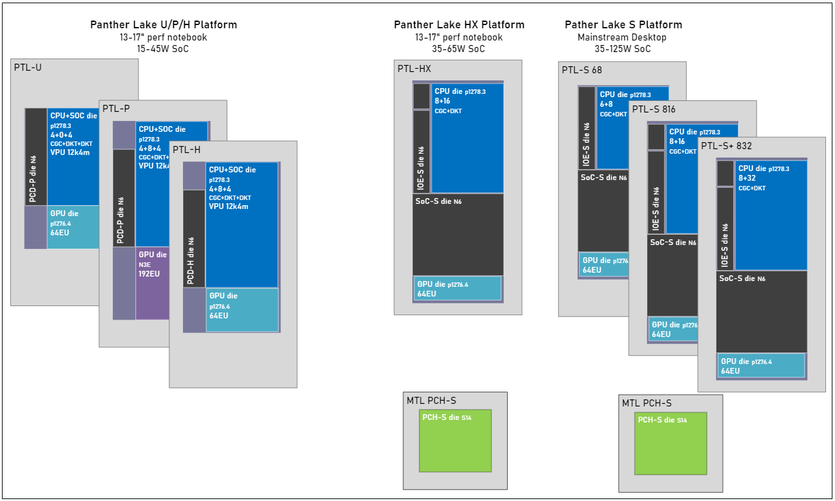
PTL U/P/H Die Config
U:10-20; P:15-35 (28W); H 20-55W (45W)
Notes:
Core Count
GPU Die
Peripheral Controller Die
Hx Package 37.5 x 30mm

Slide 4

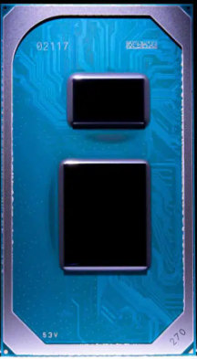
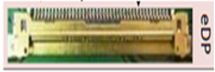
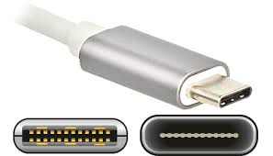
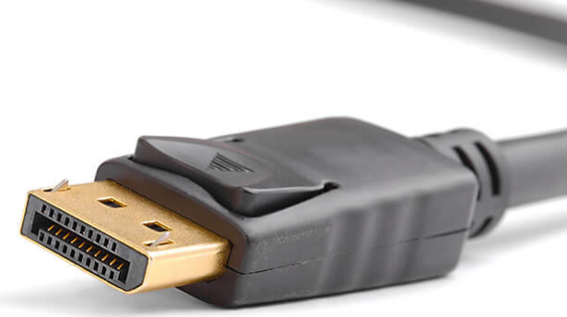
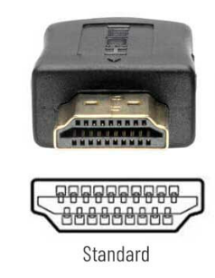
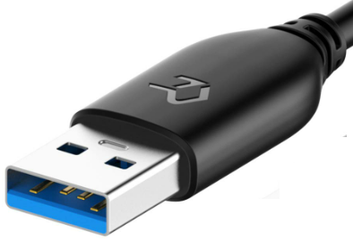

Client Silicon – TCSS Block Feature
21 Configuration !!!!!
Innovation (Modular I/O)

Slide 5
Modular TCSS I/O Card (USB3.2/DP/eDP/HDMI)
Dynamic module detection and I/O software & firmware Framework
Modular Design Connector Pinout
Electrical Budget Distribution
Re-usable RVP module across all the platform

Slide 6
UFS CEM AIC

Slide 7
RVP U/P/H BASE SKU
Base RVP SKU | SKU Description | Remarks
RVP1 | PTL UPH - T3 - LP5/x Memory Down (7500Mbps) | BOM SKUs for Chrome, PnP; Propose MemSD as Golden Config
RVP2 | PTL UPH - T3 - dTBT Barlow – LP5/x CAMM (7500Mbps)
RVP3 | PTL UPH - T4 – LP5/x Memory Down (8533/9600*Mbps) | BOM SKU for PnP and also Board SKU for PPV
RVP4 | PTL UPH –T3 - DDR5 SODIMM (7200Mbps) | also Board SKU for PPV
RVP will be designed with superset requirement of PTL-P/H for PD
RVP1 Golden Config with solder down LP5, Socket will be available for EV team
RVP3 will support both high speed memory 8533 and 9600Mbps
U silicon e-POR speed 6800 Mbps LP5 (RVP1) and 6400 DDR5 (RVP4)
UFS support via PCIe CEM riser card on RVP1 and RVP4
Opens
Alignment between pnp,

Slide 8
T4 RVP PTL-P/U/H SKU

Slide 9
T3 RVP PTL-H/U/P SKU

Slide 10




T3 RVP PTL-H/U/P CHROME SKU

Slide 11
T3 RVP PTL-H/U/P SKU

Slide 12
T3 RVP PTL-U/P/H DDR5 SKU

Slide 13
PD
POWER DELIVERY
SOC IA / GT PHASE
USB-C POWER DELIVERY

Slide 14
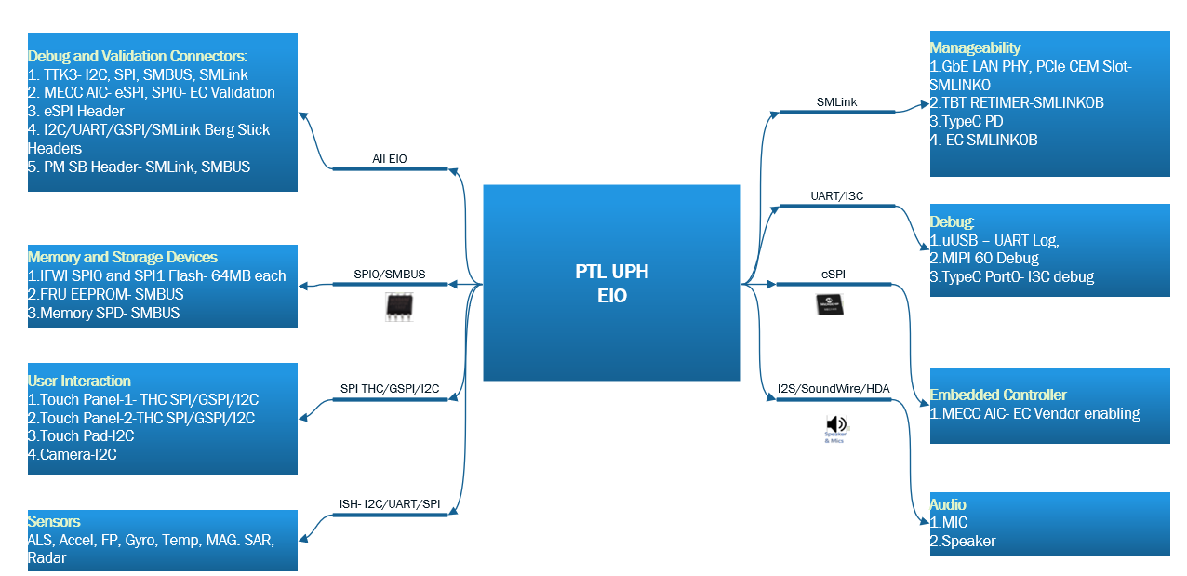
LSIO

Slide 15
PTL-UPH RVP SKU List – WW49’22 (WIP – Initial list)
PTL-UPH RVP Base SKU
PTL-UPH LP5x T3
PTL-UPH dTBT T3 LP5x CAMM
PTL-UPH LP5x T4
PTL-UPH DDR5 T3
Board SKU or BOM SKU | SKW | PTL-UPH RVP SKU Name | Memory | PCB Type | Validation Config | Comments
Board SKU | UPH-01 | PTL-UPH LP5x T3 Mem Skt | 7400 1R/2R | T3 - 10+6 Layer | TBD | Memory Socketed, Limited to Memory validation teams
BOM SKU | UPH-02 | PTL-UPH LP5x T3 MemSD |  |  |  | Memory Soldered Down
BOM SKU | UPH-03 | PTL-UPH LP5x T3 MemSkt PnP |  |  |  | Memory Socketed, PnP SKU
BOM SKU | UPH-04 | PTL-UPH LP5x T3 MemSD Chrome |  |  |  | Memory Soldered Down, Chrome SKU
Board SKU | UPH-05 | PTL UPH LP5x CAMM dTBT T3 | 7400 1R/2R (iPOR) | T3 - 10+6 Layer | Delta Config | dTBT - Barlow Ridge
BOM SKU | UPH-06 | PTL UPH LP5x CAMM dTBT T3 Chrome |  |  |  | Chrome SKU
Board SKU | UPH-07 | PTL-UPH LP5x T4 Mem Skt | 8533 1R/2R | T4 2x2+, 10+6 Layer | TBD | Memory Socketed
BOM SKU | UPH-08 | PTL-UPH LP5x T4 MemSD |  |  |  | Memory Soldered Down
BOM SKU | UPH-09 | PTL-UPH LP5x T4 MemSkt PnP |  |  |  | Memory Socketed, PnP SKU and EVO SKU
Board SKU | UPH-10 | PTL-UPH LP5x T4 MemSD PPV |  |  |  | PPV SKU for UP
Board SKU | UPH-11 | PTL-UPH DDR5 T3 | SODIMM - 7200 1DPC | T3 - 10+6 Layer | Delta Config | Limited to Memory validation
Board SKU | UPH-12 | PTL-UPH DDR5 T3 PPV |  |  |  | PPV SKU for H
SKW – SKU Key Word
Board SKU – Tape Out/Main Board
BOM SKU – Derivative SKU
Notes:
Common RVP SKUs for all UPH packages (with different TDP)
Refer RVP LZ for Base SKU feature set and Type C port mapping in our SharePoint
Lead Validation SKU / Golden Config is TBD
All boards PD will be configured to support 45W, for accurate PnP measurement on 15W/28W we will have Feature rework planned
Same PTL-UPH LP5x T4 RVP SKU supports both higher memory speed – 8533 and 9600. PTL silicon with 9600 support is thru binning (Decision Forum planned in WW02)

Slide 16

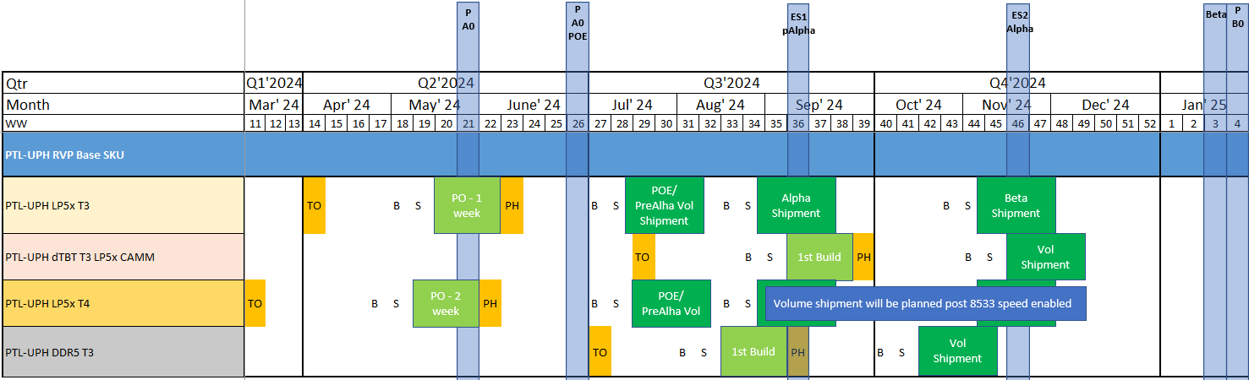
PTL-UPH RVP schedule plan (WIP) – WW49’22
Planned Dock dates
Schedule plan is WIP – need to be ratified in PXT/PVST/MC
Plan is to provide LP5 T3 and LP5 T4 SKU for PLT-P A0 PO
Followed by dTBT/CAMM SKU and DDR5 SKU which would be Taped Out post PTL-P Platform POE

Slide 17
PTL-UPH Kit/AIC List – WW49’22 (WIP – Initial list)
 |  |  |  |  | RVP + Boot Kit Matrix (Kit items which will shipped along with board)
Kit Category | Kit Item | IPN | Qty per Board |  | UPH-01 UPH-03 | UPH-02 UPH-04 | UPH-05 UPH-06 | UPH-07 UPH-09 | UPH-07 UPH-09 | UPH-08 UPH-10 | UPH-07 UPH-09 | UPH-11 | UPH-11 | UPH-12 |  | Reuse from Previous Programs |  | Comments
Boot Kit | CPU MCP Socket |  | 1 |  | Yes | Yes | Yes | Yes | Yes | Yes | Yes | Yes | Yes |  |  | No
 | CPU MCP Retention HW (Heatsink with Fan) |  | 1 |  | Yes | Yes | Yes | Yes | Yes | Yes | Yes | Yes | Yes |  |  | No
 | LPDDR5 Device (4 per board) |  | 4 |  | Yes |  |  | Yes | Yes |  | Yes |  |  |  |  | No
 | LPDDR5 Socket (4 per board) | M15275-001 | 4 |  | Yes |  |  | Yes | Yes |  | Yes |  |  |  |  | Yes??
 | LPDDR5 HW Assy (T4) | M16851-001 | 1 |  | Yes |  |  | Yes | Yes |  | Yes |  |  |  |  | Yes??
 | CAMM Module |  | 1 |  |  |  | Yes |  |  |  |  |  |  |  |  | No
 | CAMM Retention HW |  | 1 |  |  |  | Yes |  |  |  |  |  |  |  |  | No
 | DDR5 SODIMM module |  | 2 |  |  |  |  |  |  |  |  | Yes | Yes | Yes |  | Need to Check
AIC | Type C PD AIC (TI) EPR 48V - (H) |  |  |  | NA |  |  |  |  |  |  |  |  |  |  | ARL-P |  | Re-Build for PTL-UPH
 | Type C PD AIC (TI) EPR 28V - (P & U) |  |  |  |  |  |  |  |  |  |  |  |  |  |  | No
 | STM - USBC 40Gbps retimer (Volume) |  |  |  |  |  |  |  |  |  |  |  |  |  |  | No |  | TCSS-USBC module retimer
 | STM - USBA redriver |  |  |  |  |  |  |  |  |  |  |  |  |  |  | No |  | TCSS-USBA module redriver
 | STM - USBC retimerless |  |  |  |  |  |  |  |  |  |  |  |  |  |  | No |  | TCSS-USBC module retimerless
 | STM - USBC Cable |  |  |  |  |  |  |  |  |  |  |  |  |  |  | No |  | TCSS-USBC module Cable topology
 | STM - USBC 20Gb single retimer |  |  |  |  |  |  |  |  |  |  |  |  |  |  | No |  | TCSS-USBC module 20GB single retimer
 | STM - HDMI 6Gbps |  |  |  |  |  |  |  |  |  |  |  |  |  |  | No |  | TCSS-HDMI module 6GBPS
 | STM - HDMI 12Gbps redriver (Volume) |  |  |  |  |  |  |  |  |  |  |  |  |  |  | No |  | TCSS-HDMI module 12GBPS redriver
 | STM - eDP |  |  |  |  |  |  |  |  |  |  |  |  |  |  | No |  | TCSS-eDP module
 | RVP DAC |  |  |  |  |  |  |  |  |  |  |  |  |  |  | Yes
 | UCP Card |  |  |  |  |  |  |  |  |  |  |  |  |  |  | No
 | Littlemount AIC UFS 3.0 (PTL-U only) |  |  |  |  |  |  |  |  |  |  |  |  |  |  | No
 | Spider card and cable | J20358-102 |  |  |  |  |  |  |  |  |  |  |  |  |  | Yes
Spare / Misc | Probing HW for CAMM memory |  |  |  | NA |  |  |  |  |  |  |  |  |  |  | No
 | 1x TDP 15W |  |  |  |  |  |  |  |  |  |  |  |  |  |  | No
 | 1x TDP 28W |  |  |  |  |  |  |  |  |  |  |  |  |  |  | No
 | AC Brick - 230W with Power Cord | J82210-001 G38241-001 |  |  |  |  |  |  |  |  |  |  |  |  |  | Yes |  | Teams to plan and reuse from previous Gen; Orders to be limited to teams who ship boards externally
 | Battery Pack with Cable |  |  |  |  |  |  |  |  |  |  |  |  |  |  | Need to Check
 |  |  | Qty as per usage |  |  |  |  |  |  |  |  |  |  |  |  |  |  | STM - Sleek TypeC Modules (TCSS modules)
Qty as per usage

Slide 19
PTL Platform I/O: U/P/H
Interface | MTL-P | PTL-U | PTL-P | PTL-H
eDP | 2x4 eDP1.4b DDI: DP1.4b/HDMI 2.0b | 1x4 eDP1.5 | 1x4 eDP1.5 | 1x4 eDP1.5
MIPI | Removed | Removed | Removed | Removed
Concurrent Dual Display | eDP/eDP; | N/A (Optional with eDP/Type-C) | N/A (Optional with eDP/Type-C) | N/A (Optional with eDP/Type-C)
USB Type C | 4 ports CIO40: USB4.0 + TBT4 + DP 2.0 HDMI 2.1 | 3 ports CIO40: USB4.0 + TBT4 + DP 2.1 HDMI 2.1+eDP | 4 ports CIO40: USB4.0 + TBT4 + DP 2.1 HDMI 2.1+eDP | 4 ports CIO40: USB4.0 + TBT4 + DP 2.1 HDMI 2.1+eDP
MIPI CSI | 5 total / 4 concurrent D-PHY 2.1 2.5Gbps | 3 total / 2 concurrent D-PHY 2.1 2.5Gbps | 4 total / 3 concurrent D-PHY 2.1 2.5Gbps | 4 total / 3 concurrent D-PHY 2.1 2.5Gbps
PCIe | 28 total lanes x8 Gen5 (PEG IO) x20 Gen4 | 12 total lanes x4 Gen5 (PEG IO) 2x4 Gen4 | 12 total lanes x4 Gen5 (PEG IO) 2x4 Gen4 | 20 total lanes x12 Gen5 (PEG IO) 2x4 Gen4
SATA (Muxed PCIe) | 2 SATA 3.0 | Removed | Removed | Removed
GbE (Muxed PCIe) | 1x 1GbE Port | 1x 1GbE Port | 1x 1GbE Port | 1x 1GbE Port
GPIO & Boot Voltages | 1.8V Only | 1.8V Only | 1.8V Only | 1.8V Only
USB3 | 2 ports USB3 10G | 2 ports USB3.2 10G | 2 ports USB3.2 10G | 2 ports USB3.2 10G
UFS | - | UFS3.1 Gear4 | - | -
USB2 | 10 ports USB 2.0 | 8 ports USB 2.0 | 8 ports USB 2.0 | 8 ports USB 2.0
CNV (WiFi / BT) | 802.11ax R2 w/TBDC (160+80), BT 6 D-Phy 2.1 | Wifi 7 2x2 | Wifi 7 2x2 | Wifi 7 2x2
Notes:
eDP 1.5: PSR2+VDSC 1.2a w/FEC

